Slide 1

SMART COLLEGE MANAGEMENT SYSTEM (BCSE0455)
Department of Computer Science and Engineering
CSE-TWINNING
(Submitted To: Ms. Ayushi)
Group Members
Name of Member | Roll Number | Role | Department & Section
Subrat Panigrahi (Team Lead) | 2401331930039 |  | CSE-TWINNING
Sumit Kumar Singh (Member) | 2401331930040 |  | CSE-TWINNING
Abhinandan Kumar (Member) | 2401331930002 |  | CSE-TWINNING

Slide 2

Index
Introduction
Literature Survey/Existing System
Problem Statement
Proposed Methodology
Flowcharts and Use Case/ER Diagrams
Feasibility Study
Hardware /Software Requirement
Results and Conclusion
References
Live Demonstration of Project with screenshots in ppt+

Slide 3
Introduction
Definition:
SCMS is a web-based centralized system for managing college operations.
Developed using HTML, CSS, Bootstrap, JS, PHP, MySQL
Key Goals:
Automate academic + administrative tasks
Reduce manual errors
Provide real-time data access
Enable analytics-based decisions
Learning Outcomes:
CRUD Operations
Session Management
Database Normalization (3NF)
Secure Authentication

Slide 4
Literature Survey/Existing System
Manual Expense Tracking
Attendance recorded in registers
Marks stored in paper files
Fee records maintained manually
Drawbacks
Time-consuming
Human errors
Data loss risk
No analytics
Spreadsheet-Based Systems
Excel-based records
Manual formula calculations
Drawbacks
Requires technical knowledge
Risk of accidental data deletion
No proper security
No role-based access
Mobile & Web Applications
Online Smart College Management System apps
Cloud-based storage

Slide 5
Problem Statement
Identified Problems:
Lack of centralized academic system
Manual attendance calculation
Difficulty in tracking student performance
No real-time data access
Poor transparency
Illustration (Problem Scenario):
A college maintains attendance in registers and marks in separate sheets. When semester results are needed: Teachers calculate totals manually.
Attendance percentage takes time. Errors occur frequently Students cannot view records instantly.
Purpose of the Problem Statement:
Dependence on manual methods
Lack of automation
Limited technical infrastructure and Data scattered across departments
No integrated system

Slide 6
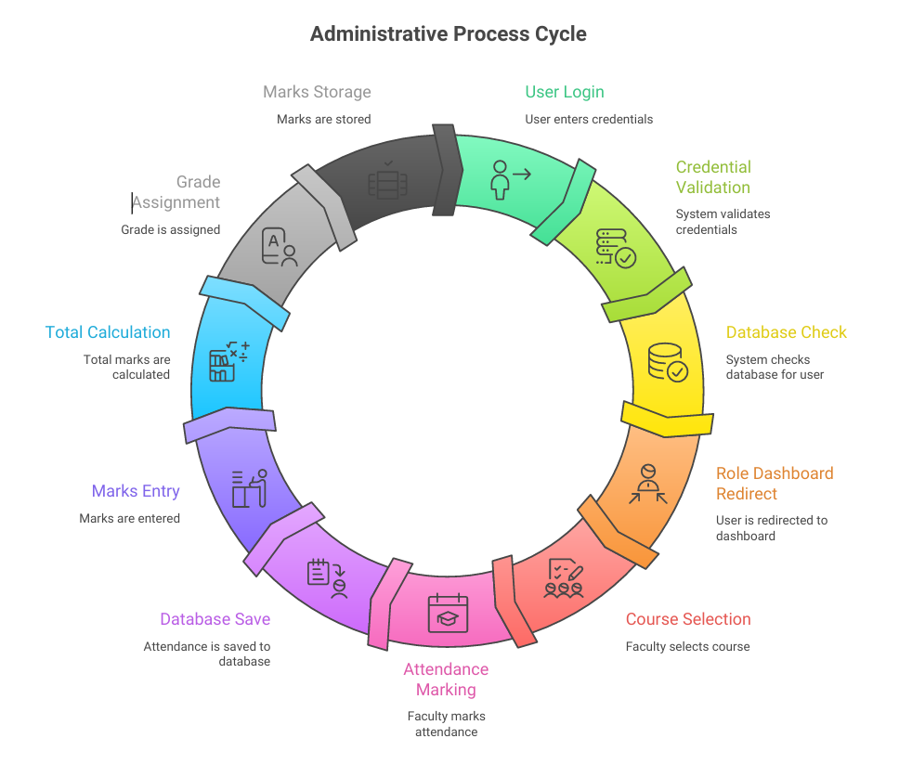
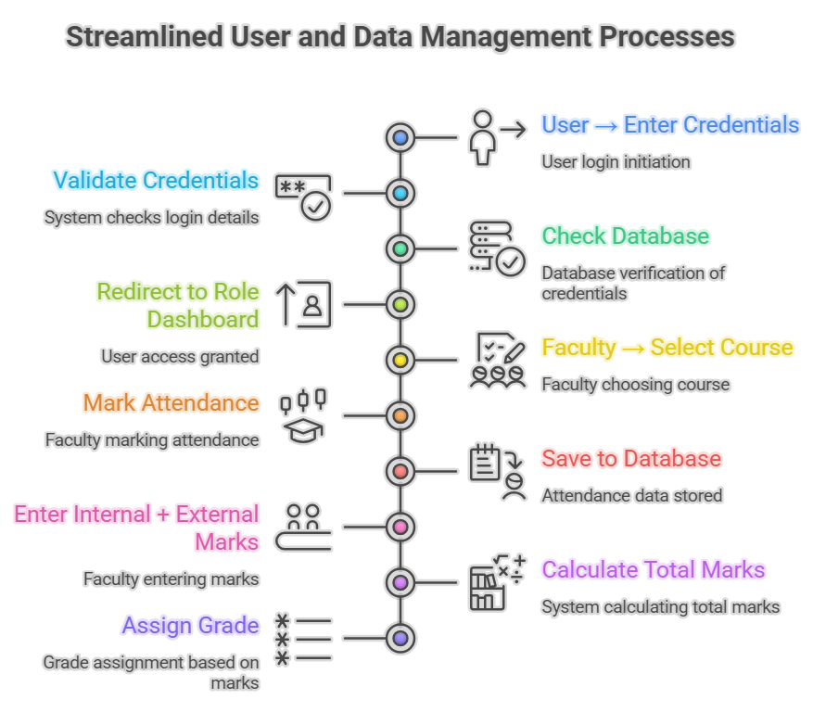
Flowcharts and Use Case/ER Diagrams

Slide 7
Feasibility Study
Technical Feasibility
Developed using PHP and MySQL
Runs on XAMPP
Uses Bootstrap for responsive UI
Works on Windows/Linux
Operational Feasibility
Easy login system
User-friendly dashboard
Minimal training required
Economic Feasibility
Uses free tools
No paid libraries
Low maintenance cost

Slide 8
Hardware /Software Requirement
Hardware Requirements
Processor: 1 GHz or above
RAM: Minimum 2 GB
Disk Space: 50 MB free space
Software Requirements
Frontend: HTML5, CSS3, Bootstrap 5
Backend: PHP
Database: MySQL
Server: XAMPP
IDE: VS Code
Browser: Chrome / Edge

Slide 9
Proposed Methodology
Why the Problem Exists
Colleges still rely on manual record keeping.
Attendance and marks are maintained separately.
Lack of centralized database system.
Limited use of automation in academic management.
No real-time monitoring of student performance.
Limitations of Current Methods
Time-consuming and error-prone
Difficult to generate summaries
Risk of data loss
Spreadsheet-Based System:
Requires technical knowledge
No proper security mechanism
No role-based access control
Existing ERP Systems is Expensive to regulate and maintain.
Need for the Project
Centralized system
Secure database storage
Role-based login
Real-time analytics
Easy-to-use interface

Slide 10
Results and Conclusion
Results
Students successfully added and managed
Attendance recorded and percentage calculated
Marks uploaded with automatic grade calculation
Fees tracked with receipt upload
Dashboard analytics displayed
Secure login implemented and System runs efficiently without errors.
Conclusion
The Smart College Management System Automates academic management.
Implements secure authentication and Uses normalized database.
Demonstrates full-stack development.
Fulfills Web Technology syllabus requirements.
It is scalable to ERP-level systems.

Slide 11
References
PHP Official Documentation
MySQL Documentation
Bootstrap Official Docs
W3Schools MDN Web Docs

Slide 12
Thank You

